Slide 1
Space Invaders
Jayden Ma and Mohamed Camara
EK131 E2 Team #10

Slide 2

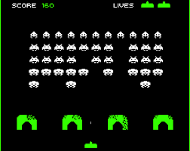
Background
Objective to make a simple and fast-paced game
Game is based on Space Invaders (1987) with a few modifications
Removed the walls and enemies shooting back
Instead the enemies come down

Slide 3
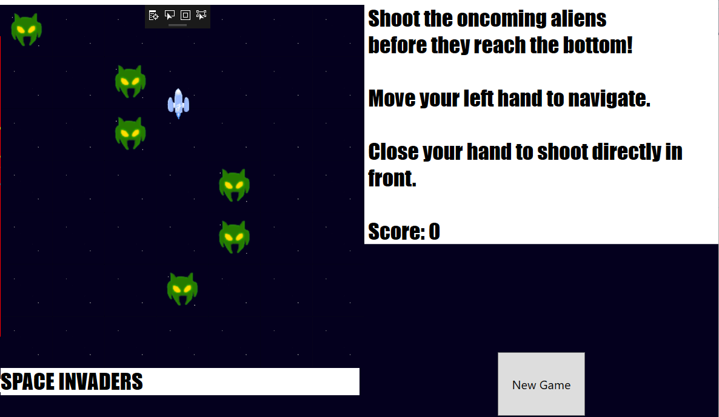
Objective
Prevent aliens from reaching the bottom
Accumulate as many points as possible doing so
Trains dexterity of player
Reaction time
Player hand movement speed

Slide 5
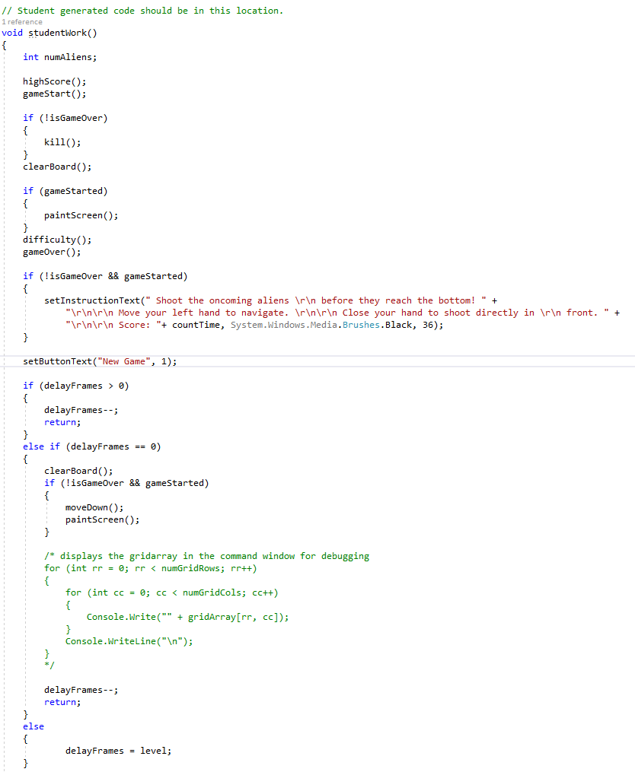
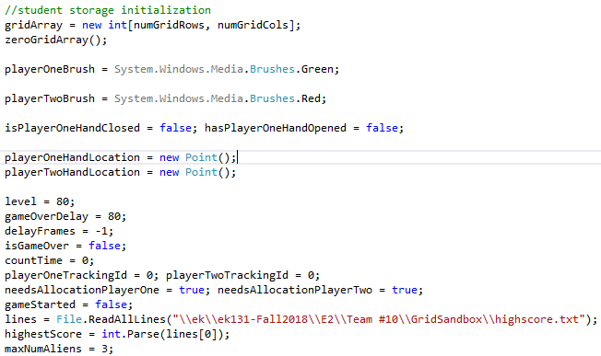
Steps
Initialization until player hand closes
Functions:
Row generation
Moving down rows
Killing aliens
Difficulty
Game over check
Highest score

Slide 6
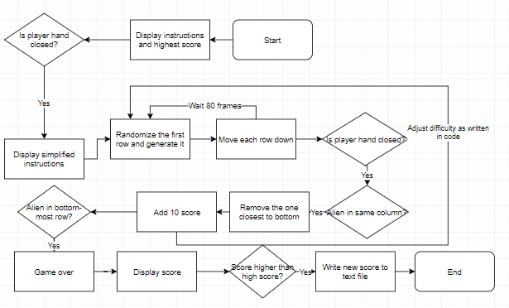

Slide 7


Difficulties
Programming inexperience led to a lot of general issues
Solution: Asking professor and TAs for help
Learned a lot about C# functions in this way and made later stages of game development easier
First major problem: How to generate the first row and move it down
Solution: A function that checked each row and column for an alien and moved it down
Became the basis for many other game mechanics
Other problems along the way: randomized row generation, high score display

Slide 8


Conclusion
Future enhancements:
More faithful to original game: put walls back in and aliens fire back
More animations to make it look better
Advanced features: special aliens and power-ups
Learned about programming, game design, and engineering in general
Hopefully we made an engaging game that will inspire those who take this module in the future

Slide 9
References
Professor Janusz Konrad - Professor, game design and programming assistance
Natalia Frumkin, Jeffrey Leong - Teaching Assistants, programming assistance
https://docs.microsoft.com/en-us/dotnet/csharp/index - General C# reference guide
https://stackoverflow.com/ - Specific help for certain game mechanics

